Slide 1
Twitter Message Data Transformation : SENTIMENT ANALYSIS
By:
Sri Harish Reddy Alla (2824635)

Slide 2
Outline
Introduction
Data Preparation
Data Preprocessing
Dropping columns technique
Dataset Splitting
Text Tokenization
Pad sequence technique
Modeling
Model structure
Model Compiling and Training
Prediction In Action
Model Evaluation Metrics Used
Results in Accuracy and Comparisons
Discussion and Conclusions

Slide 3
INTRODUCTION
Sentiment Analysis is one of the applications of the Natural Language Processing techniques.
Various NLP techniques are used to analyse social media posts and know what customers think about their products.
This helps in understanding the issues and problems that their customers are facing by using their products.
Sentiments is feelings, emotions, opinions likes/dislikes bad/good etc.

Slide 4
Intro contd..
Sentiments analysis is a task in Natural Language Processing and Information Extraction that looks for writers' feelings reflected in favourable or unfavourable remarks, queries, and requests by looking through a huge number of documents.
In the study of human behaviour, we take user sentiment and emotion out of plain text to determine their opinions.
The aim is to determine whether a text's opinion is good or negative.

Slide 5
Data Preparation
Data preparation was done by reading the dataset from the input directory (my google drive).
The datasets are in csv format.
Using pandas python library We were able to read the dataset in a dataframe format as shown by the output in the next slide.
The source of the dataset have two copies,
This will have our predefined training and testing data splits as opposed to the original two sets of data provided from the dataset source.

Slide 6
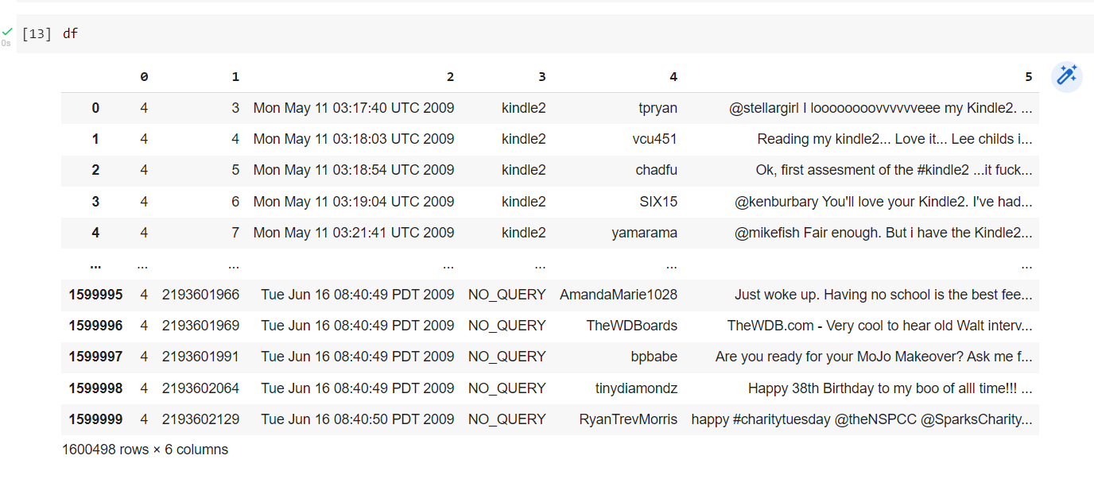
Data Preparation contd..

Slide 7
Data Preprocessing
Data pre-processing is a crucial part as it helps in enhancing dataset review, processing and clean-up.
The techniques makes sure that the dataset is ready to be fed to the model.
In pre-processed format, the dataset can be precisely understandable by the model.

Slide 8
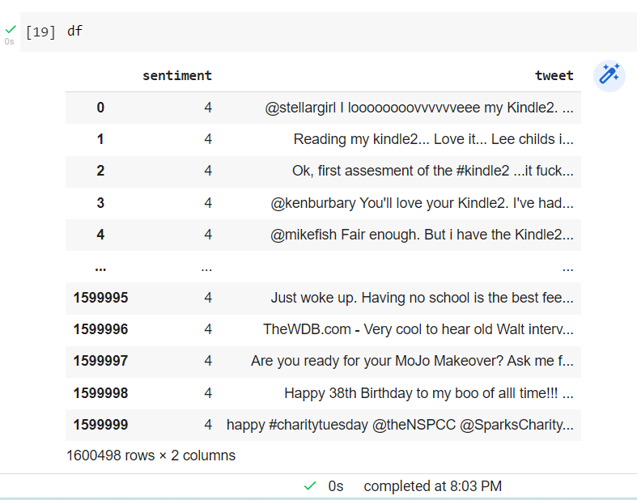
Dropping columns technique
This stage started with dropping columns technique.
Renaming of remaining columns was hence done.
Column 0 was renamed to sentiment whereas column 1 was renamed to tweet.

Slide 9
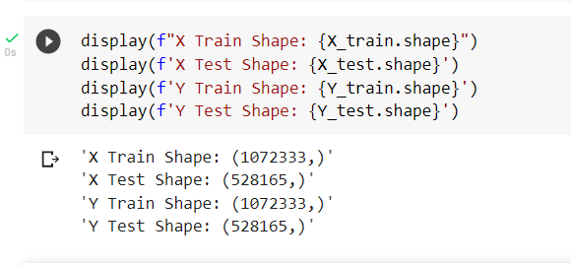
Dataset Splitting
This was splitted by the help of the train_test_split predefined method from sklearn python library.
With a test size of 0.33 dataset samples and a random state threshold of 0 below was the output shape of each split.

Slide 10
Text Tokenization.
We had to use a maximum of 10000 words to tokenize.
Tensorflow method is more preferable in this project to tokenize text instead of using NLTK Library as proposed. However, using either should work as expected.
Tokenization is therefore done, to have a tokenized text content.
This helps in the vectorization process and making the dataset ready for modelling stage in a pre-processed format.
With vectorization and indexing checks, the dataset reveals 527562 independent tokens.
The word Index dictionary file is saved to the output folder found in the root folder (working directory).

Slide 11
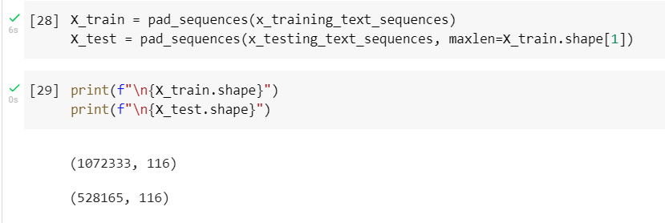
Pad Sequences technique.
Padding of sequences is employed to ensure that all sequences in a list are of the same length, in the pre-processing stage.
By default, this facilitates padding 0 to each of the sequences, until every sequence in the list has the same length as the longest sequence.

Slide 12
Model structure
Deep learning models are trained using neural network architecture using of data which are well labelled using multiple layers.
Deep Learning models do exceed human level performance.
These architectures have the ability to do feature learning from the dataset.
The sentiment analysis model was designed to have 8 layers with an output layer with softmax activation.
The summary screenshort below shows the layers added to model, output shape and the parameters which will be used for training, non-training.

Slide 13
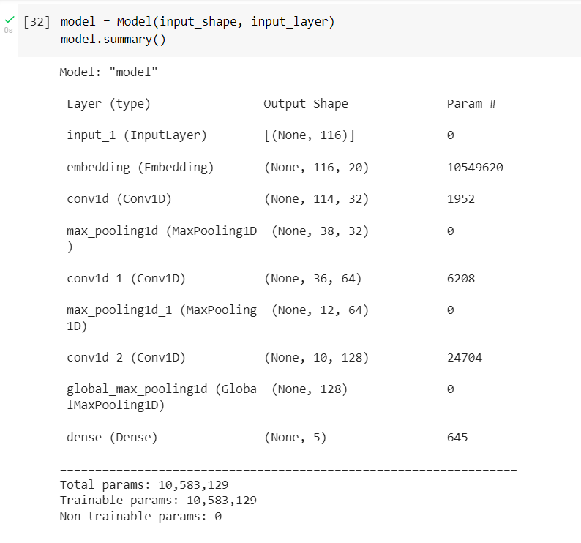
Model structure contd..

Slide 14
Model Compiling and Training
Compiling the model was the first step to take followed by the training.
The model is forced to compile by default parameters if you don’t compile it.
The compiling was done under loss function with sparse_categorical_crossentopy parameter, metric function with metric index parameter, and SGD as the optimizer parameter.

Slide 15
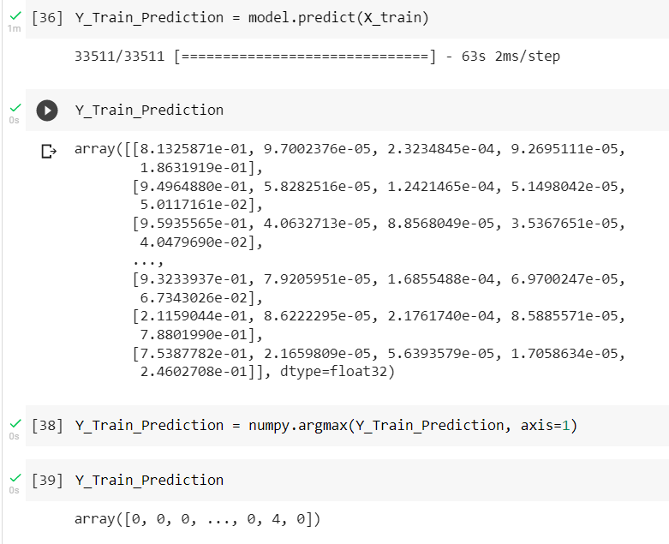
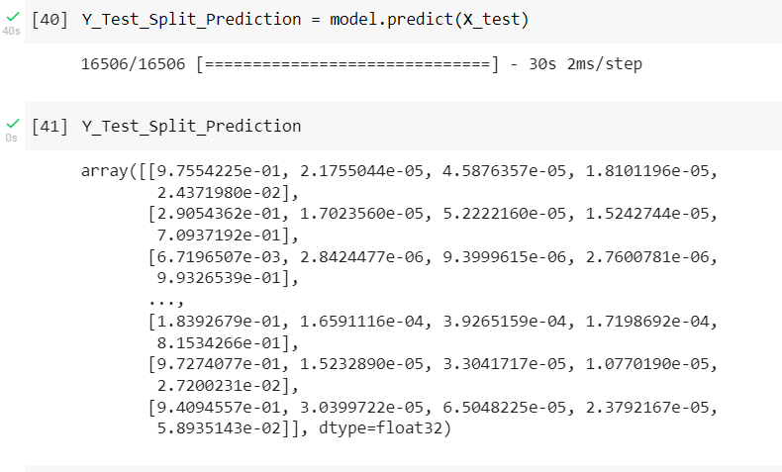
Prediction In Action
Prediction was done on the training set of the data and the testing set of the data respectively.

Slide 16
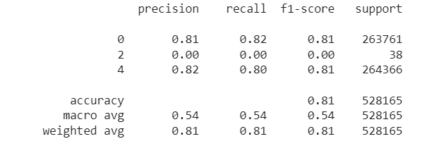
Model Evaluation Metrics Used
The model metrics tries to do performance evaluation on a model.
It is important to note the model evaluation metrics used in this project.
Below screenshots try to give a highlight on that.

Slide 17
Results in Accuracy and Comparisons
The output helps by providing a know how the model predicts.
Using the model metrics print out, The accuracy was not that so bad as the accuracy threshold on testing.
Split set was 0.81 which shows a good starting point of the model performance.
Confusion matrix of the Y test split data was as below:

Slide 18
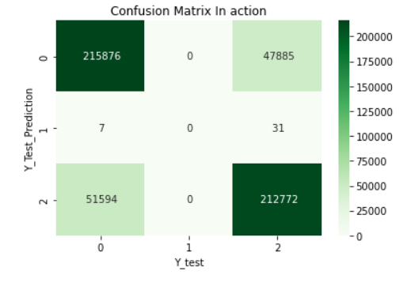
Confusion matrix of the Y test split

Slide 19
Discussion and Conclusions
The model was a bit good but with less performance, on the accuracy.
To enhance performance, the model might be able to have a high capability compared to the current accuracy.
Having a better dataset preprocessing approach should enhance a better performance on our model.

Slide 20
the following should be recommended:
Thresholding, It is advisable to use a threshold value of 0.5.
However, it is again advisable to use the best threshold that works best on different types of models.
Threshold simply rules out the projected probability scores into a class label.
Incase of normalized probabilities, for example in the range of 0 and 1, and no threshold value is chosen, then the threshold value to use is always defaulted to 0.5.

Slide 21
Contd…
Dataset Resampling, a simple and concise resampling technique method may improve the model in the best way possible.
“Generally, resampling techniques for estimating model performance operate similarly: a subset of samples are used to fit a model and the remaining samples are used to estimate the efficacy of the model. This process is repeated multiple times and the results are aggregated and summarized. The differences in techniques usually center around the method in which subsamples are chosen”. — Page 69, Applied Predictive Modeling, 2013.
K-Fold technique should be a recommendation on this sentiment model.
However, one might try to enumerate between K-Fold and bootstrap resampling methods as well.

Slide 22
Contd…
In conclusion, other applicable data preprocessing and modeling techniques are not limited to be used in trying to enhance a better improvement on the model performance.
A better implementable approach increases chances of having a better engineered model.

Slide 23
Thank you!

